Slide 1
Detecting Dementia: Emerging Innovations and Their Implications for American Adults and Their Health Care
We will begin shortly!
October 16, 2024| 1:00 – 2:00 PM ET

Slide 2
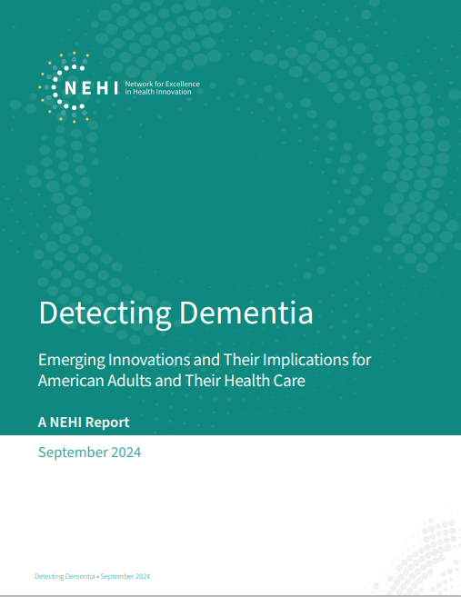
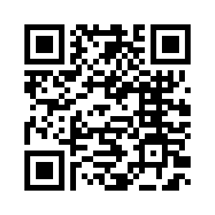
SCAN this QR code to view our recent report

Slide 3




Thank you to our panelists for participating in our discussion today
Elli Kaplan, MBA
Neurotrack
Vijaya Kolachalama, PhD, FAHA
Boston University School of Medicine
Jennifer Pollack, JD
Alzheimer’s Association & Alzheimer's Impact Movement
Claire Sexton, DPhil
Alzheimer’s Association
3

Slide 4

Key Points
Dementia hidden in plain sight
  Historically, clinical detection of dementia mostly occurs when symptoms are apparent
Missed opportunities
  Patients miss opportunities for risk reduction and early intervention (preventive health measures, treatment when warranted)
Growing evidence of multiple markers of dementia
  Research suggests that cognition is only one marker of dementia and related conditions
Markers of dementia may be pre-symptomatic
  Research also suggests that dementia-associated changes in the brain can occur many years before symptoms are manifest
Innovations are expanding capabilities to detect dementia
  Innovations in diagnostics and identification of novel biomarkers are creating greater capabilities for scalable, minimally or non-intrusive screening and assessment, including:
    Assessment of cognition, behavior, and patient function
    Detection of pathological biomarkers
    Predictive analysis of data integrated from multiple sources (e.g., AI-enabled analysis)
Can our health care system take advantage of these innovations?
  Our NEHI report makes several general recommendations; i.e., Reevaluate key Medicare benefits (Annual Wellness Visit, the Cognitive Assessment and Care Plan benefit, the GUIDE model) for opportunities to prove out the highest and best use of dementia screening and assessment innovations

Slide 5


Discussion kick-off
Will “brain health assessment” become an essential step in preventive medicine?

Slide 6

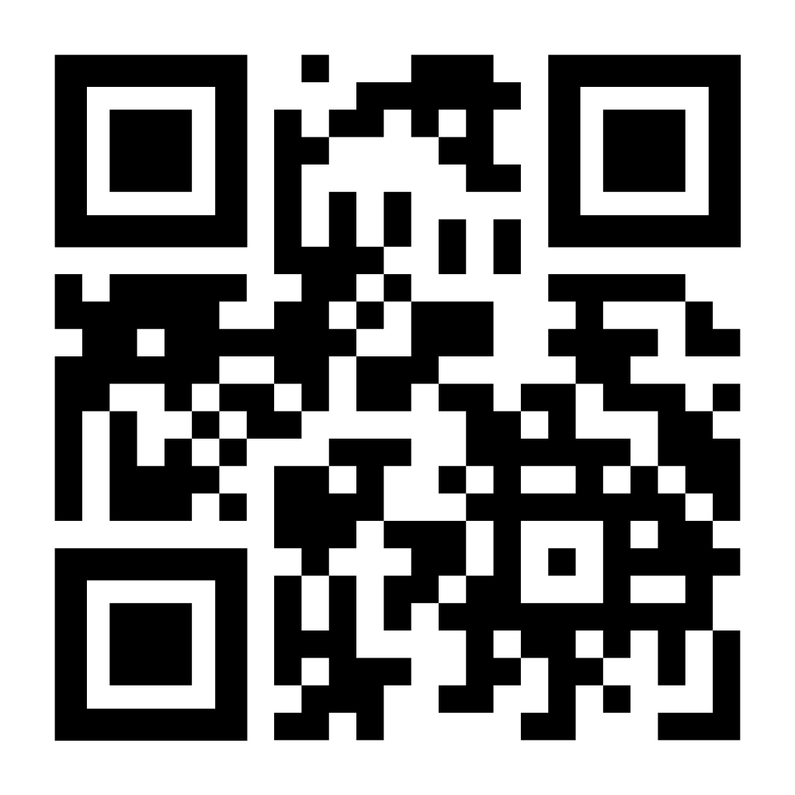
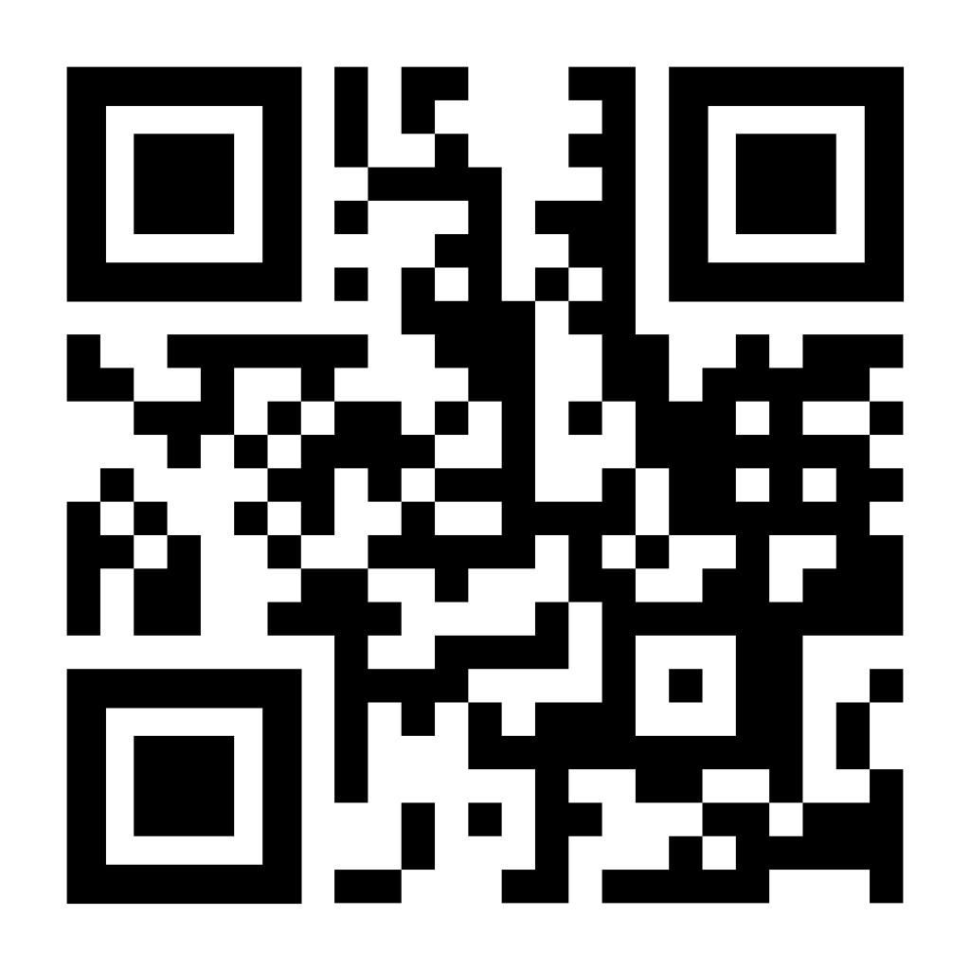
Thank You!
For questions and comments, contact:
Tom Hubbard, Senior Vice President of Policy Research, NEHI | thubbard@nehi-us.org
Lauren Bedel, Program Manager, Health Policy & Research, NEHI | lbedel@nehi-us.org
Emerging Challenges in Dementia Screening and Diagnosis of Alzheimer's Disease (February 2024)
Diagnosing Hope: The New Era of Alzheimer’s Disease Treatment (October 2023)
Detecting Dementia Report (NEW)

